Slide 1
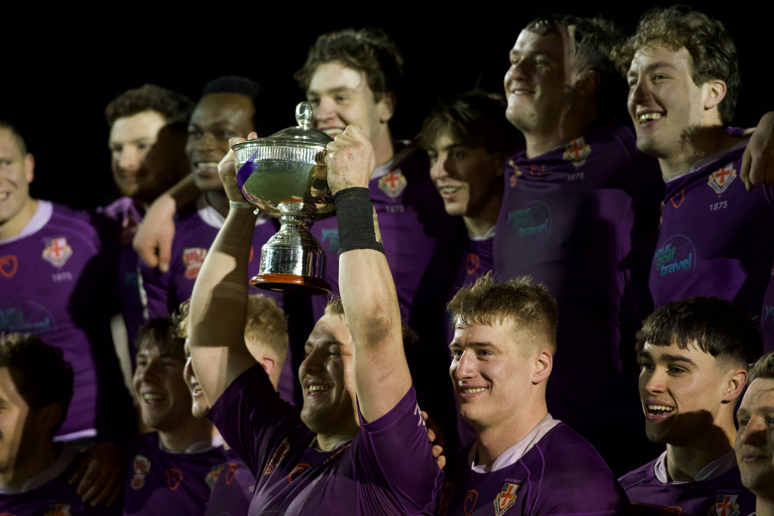
Durham University Rugby Football Club
Corporate Sponsorship Brochure
2023/24 Season

Slide 2
ABOUT US
Durham University Rugby Football Club (DURFC) dates back to 1875 and is one of the oldest rugby clubs in the UK.
The club consists of 42 Men and Women’s rugby teams. We field five competitive teams, all playing in their highest respective leagues.
Durham 1st XV has competed and continues to compete in the televised British Universities and Colleges Sport (BUCS) Super Rugby National League against 9 of the UK’s most elite university rugby clubs.
DURFC were crowned back to back BUCS SUPER RUGBY CHAMPIONS (2019-2020 & 2021-2022), for the first time in the history of the competition.
In 2020-2021, DURFC was awarded the “Core Values Club” of the year for their contribution to the university and wider community over COVID-19.

Slide 3
OUR MISSION
Excellence
DURFC aspires to continue their history as the most successful rugby club in BUCS Super Rugby , through investment in coaching, training, resources and player support
Development
DURFC is committed to the development of rugby in the North-East of England, forming links to nearby clubs and local businesses
Social impact
Over the 2021-2022 season DURFC raised over £40,000 for charity. In 2022-23, we have raised another £28,500 so far! We strive to widen our impact year-on-year through our contributions to charitable organisations.

Slide 4
INSIGHTS
DURFC has a total social media following of over 11,500 followers.
Durham University is ranked in the top 5 universities in the UK.
With a squad of over 180 players, DURFC is one of the largest men’s rugby programmes in the world with thousands of alumni all over the globe.
Durham Graduates are ranked in the top 10 in the UK and 34th in the world for employability
Our 1st XV competes in the BUCS Super Rugby League which is televised on YouTube and BUCS TV and has up to 50,000 viewers per game
Durham has been named the number 1 University for team sports in consecutive years (2021/22 & 22/23) in the UK, training at a £32m facility.

Slide 5
BENEFITS OF SPONSORSHIP
Affiliation with the largest men’s rugby club in the country
Brand exposure
Talent network opportunities
Social media exposure to over 11,500 followers.
Match day exposure to both students and social media coverage.
Increase Market audience
Access to club membership (including Alumni)

Slide 6
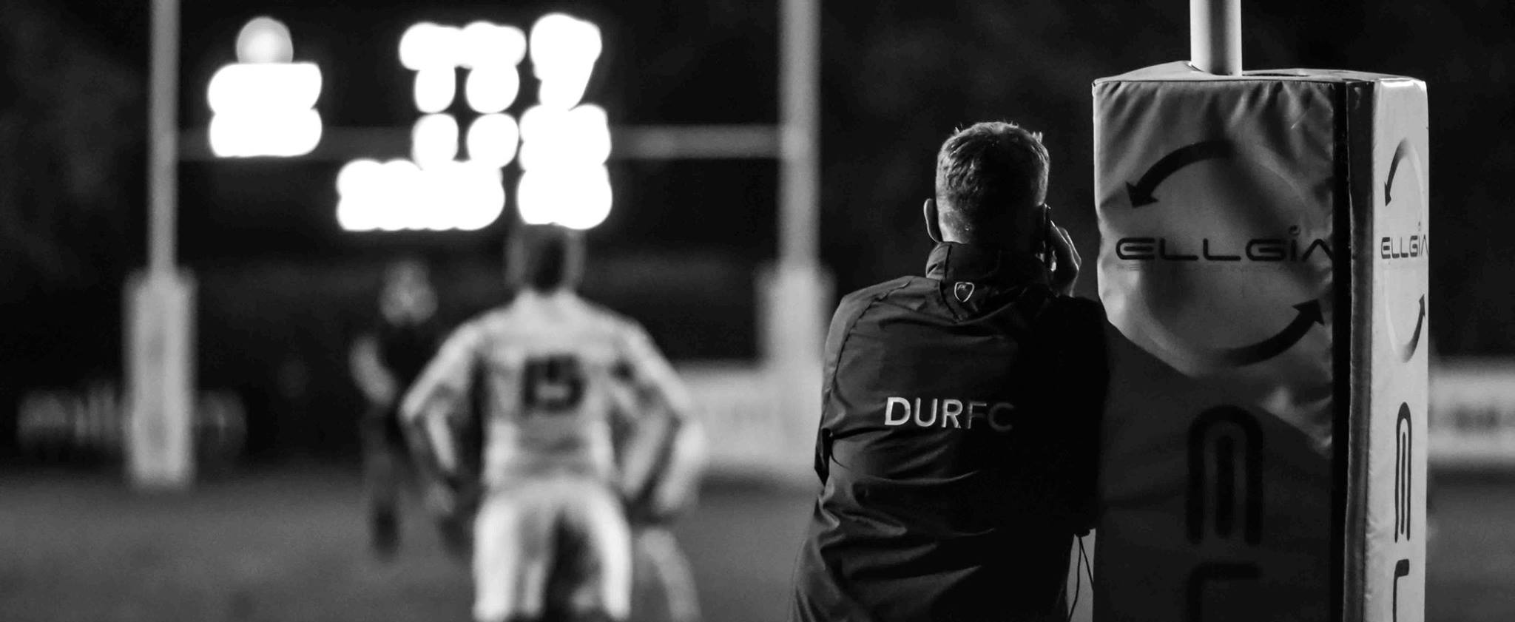
TAILORED SPONSORSHIP/ADVERTISEMENT PACKAGES
At DURFC we are committed to working closely with all our potential partners to develop a sponsorship/ advertisement package that works for your business. The following pages give an insight into the exciting opportunities we have to offer. All of our opportunities presented can be tailored to your preferences.

Slide 7
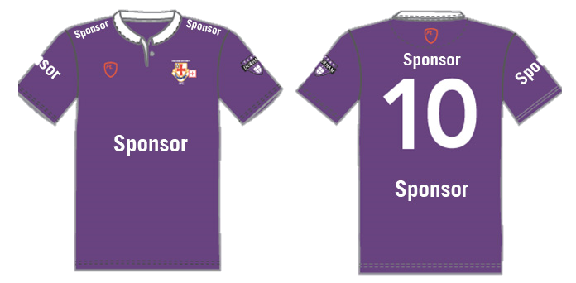
MATCH KIT/ OFFICIAL PARTNER SPONSORSHIP
Become our flagship club sponsor and have your logo displayed on every playing shirt for ALL our teams. Choose from one of the five locations on the shirt for your logo. All sponsors come with two-year minimum display term.
All prices below exclude costs of origination/artwork and printing:
Shirt Front Sponsorship from £5000 +VAT
Shirt Back Sponsorship above number from £2000 +VAT
Shirt Back Sponsorship under number from £1500 +VAT
Sleeve Sponsorship from £1000 +VAT
Shoulder Sponsorship from £1000 +VAT
Warm Up Training Shirt from £1000 +VAT

Slide 8
PALATINATE/ HOME GAME SPONSORSHIP PACKAGE
Match sponsorship
Perimeter advertising board (whole season)
Match ball sponsorships for all home games throughout the season
Team sheet and social media recognition for specified games
Palatinate sponsor recognition on website (whole season)
COST: £2000 per season (+ cost of advertising board/printing services)
SPONSOR

Slide 9
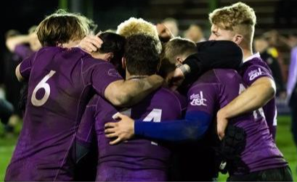
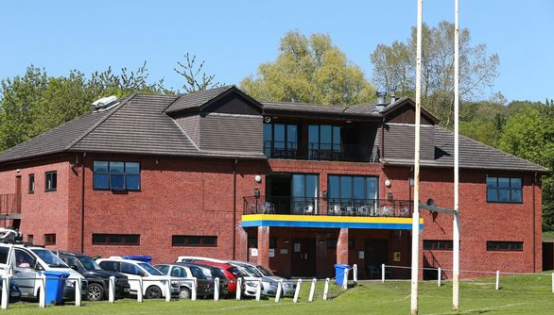
Match Day Sponsorship
Present Man of the Match awards
Sponsor recognition over the PA
Opportunity to provide pop up displays, banners and marketing materials at home games as well as during match-days on campus.
Marketing exposure to up to 5000 students per game.
Opportunity to split gate receipts and match our charitable donations (DURFC vs Exeter raised over £12,000 in gate receipts in 2021-2022).
COST: On enquiry

Slide 10
MATCH BALL SPONSORSHIP
Opportunity to provide your own pop up displays, banners and marketing materials at Hollow Drift
Sponsor recognition over the PA
Sponsor recognition on the Match Day team sheet
Present Man of the Match awards
COST: £200 per match
SPONSORED BY…

Slide 11
PLAYER SPONSOR
Sponsor an individual player across our playing squad for the whole 2023/24 season:
Sponsors name and logo displayed on our Players Page on our website: www.durhamunirugby.com, along with information about the company
Sponsors logo displayed on Team Announcement Videos, with social media followers accumulating to over 11,500 – and overall impressions far far higher.
Sponsors name and logo in weekly Match Day Programmes
Sponsors name displayed when sponsored player scores or receives a Man of the Match award
COST: £200 per player

Slide 12
PERIMETER ADVERTISING BOARD OR BANNERS
Made up in your own design and placed in strategic positions surrounding our magnificent floodlit 1st XV Pitch at Hollow Drift.
Crowd-facing boards
Average game attendance – 2,000
TV-facing boards
Average YouTube Live Stream views – 20,000
SPONSOR
SPONSOR
SPONSOR
COST:
8’ x 2’
16’ x 3’
£200 + £160 for board make-up
£300 + £160 for board make-up

Slide 13
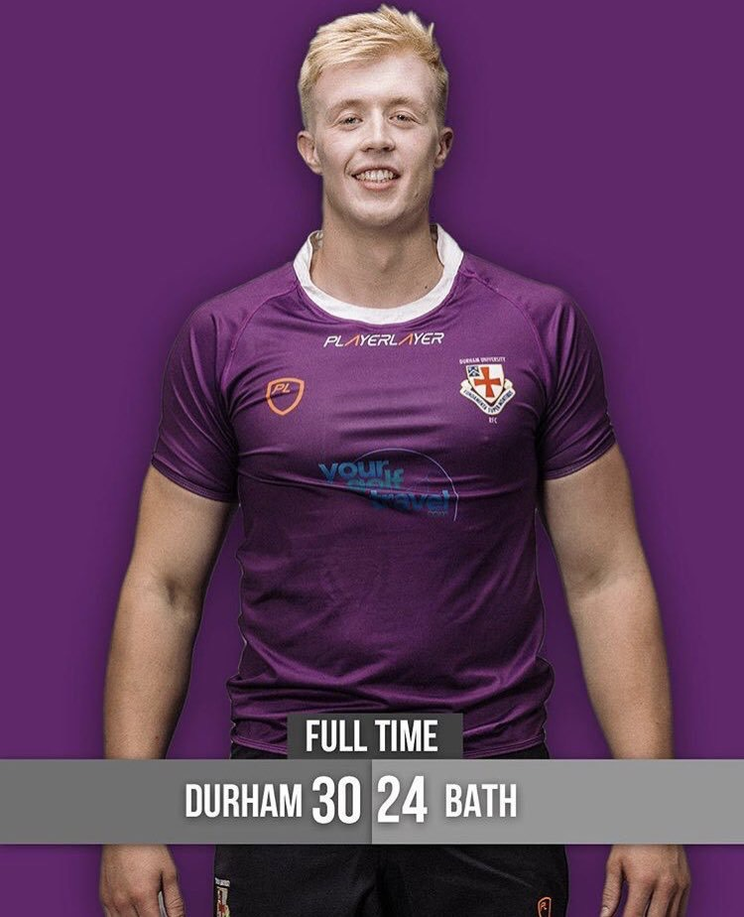
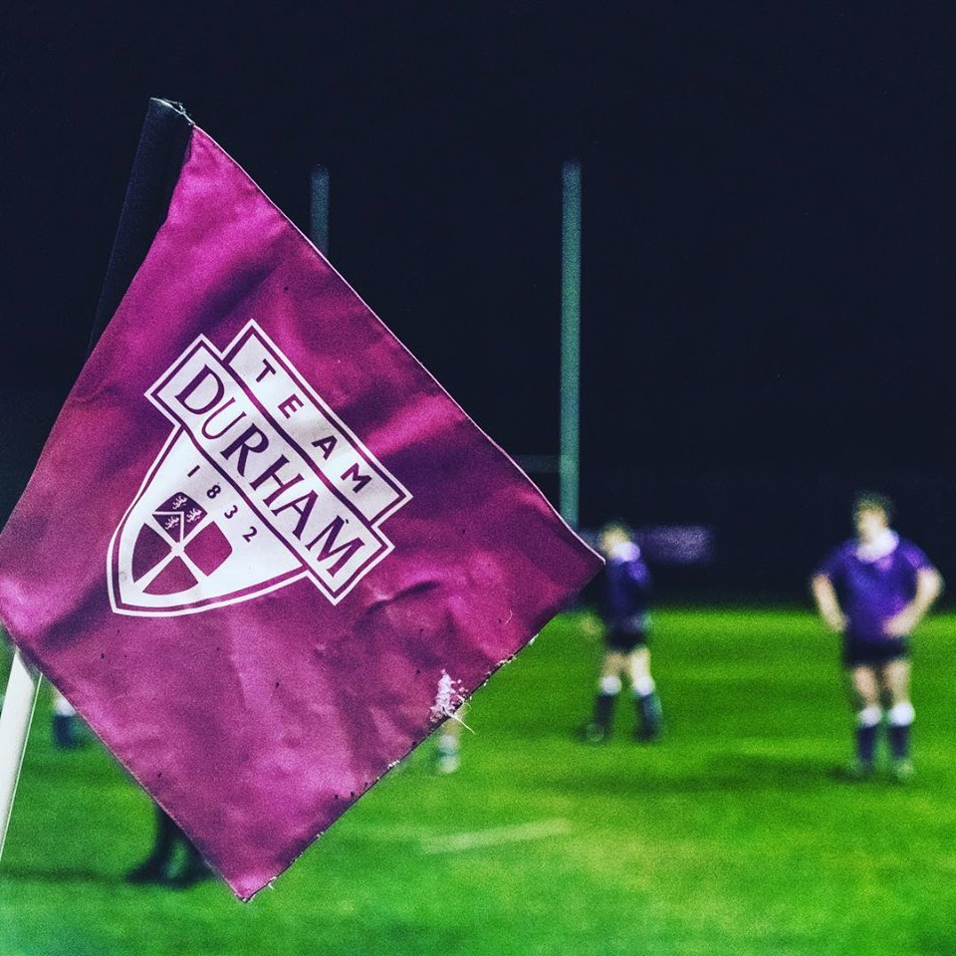
SCOREBOARD ADVERTISING
POST PROTECTOR / CORNER FLAG ADVERTISING
An exclusive advertisement on the 1st XV pitch scoreboard for the whole season to place your company name and/or logo.
An exclusive advertisement space on the 1st XV Post Protectors and the Corner Flags with your company name and/or logo on
TV-facing scoreboard
Constant media coverage
1 x Scoreboard
Constant media coverage
4 x Post Protectors
4 x Corner Flags
COST: £500 + supply/design costs
COST: 5’ x 2’ Board £400 + board costs

Slide 14
FIXTURE CARD / POSTER ADVERTISING
WEBSITE AND SOCIAL MEDIA ADVERTSING
The website www.durhamunirugby.com averages over 1,000 visitors per week and the email newsletter has over 2,000 subscribers.
An exclusive advertisement space on the 1st XV Fixture Poster to place your company name and/or logo
SPONSER
For the average match:
Instagram impressions: 30,000
Twitter impressions: 50,000
#BUCSSuperRugby impressions: 80,000
Coverage locally and nationally
Posted on all social media platforms, to over 10,000 followers.
COST: £150
COST: Please Enquire

Slide 15
On behalf of Durham University Rugby Football Club we hope you are as excited as we are for the season ahead. Rugby at Durham is in a fantastic position and the proposition of defending our title only intensifies the anticipation. We hope you decide to join us in pursuing excellence in Durham and in the wider sporting world as a whole, helping to support the many players, coaches and fans who are proud members of the DURFC community.
CONTACT US
Director of Rugby Si Culley Telephone 07305 589966 Email: simon.j.culley@durham.ac.uk
Sponsorship Officers Ollie Kershaw Telephone 07889 632705 Email: ollie.p.l.kershaw@durham.ac.uk.

Slide 16
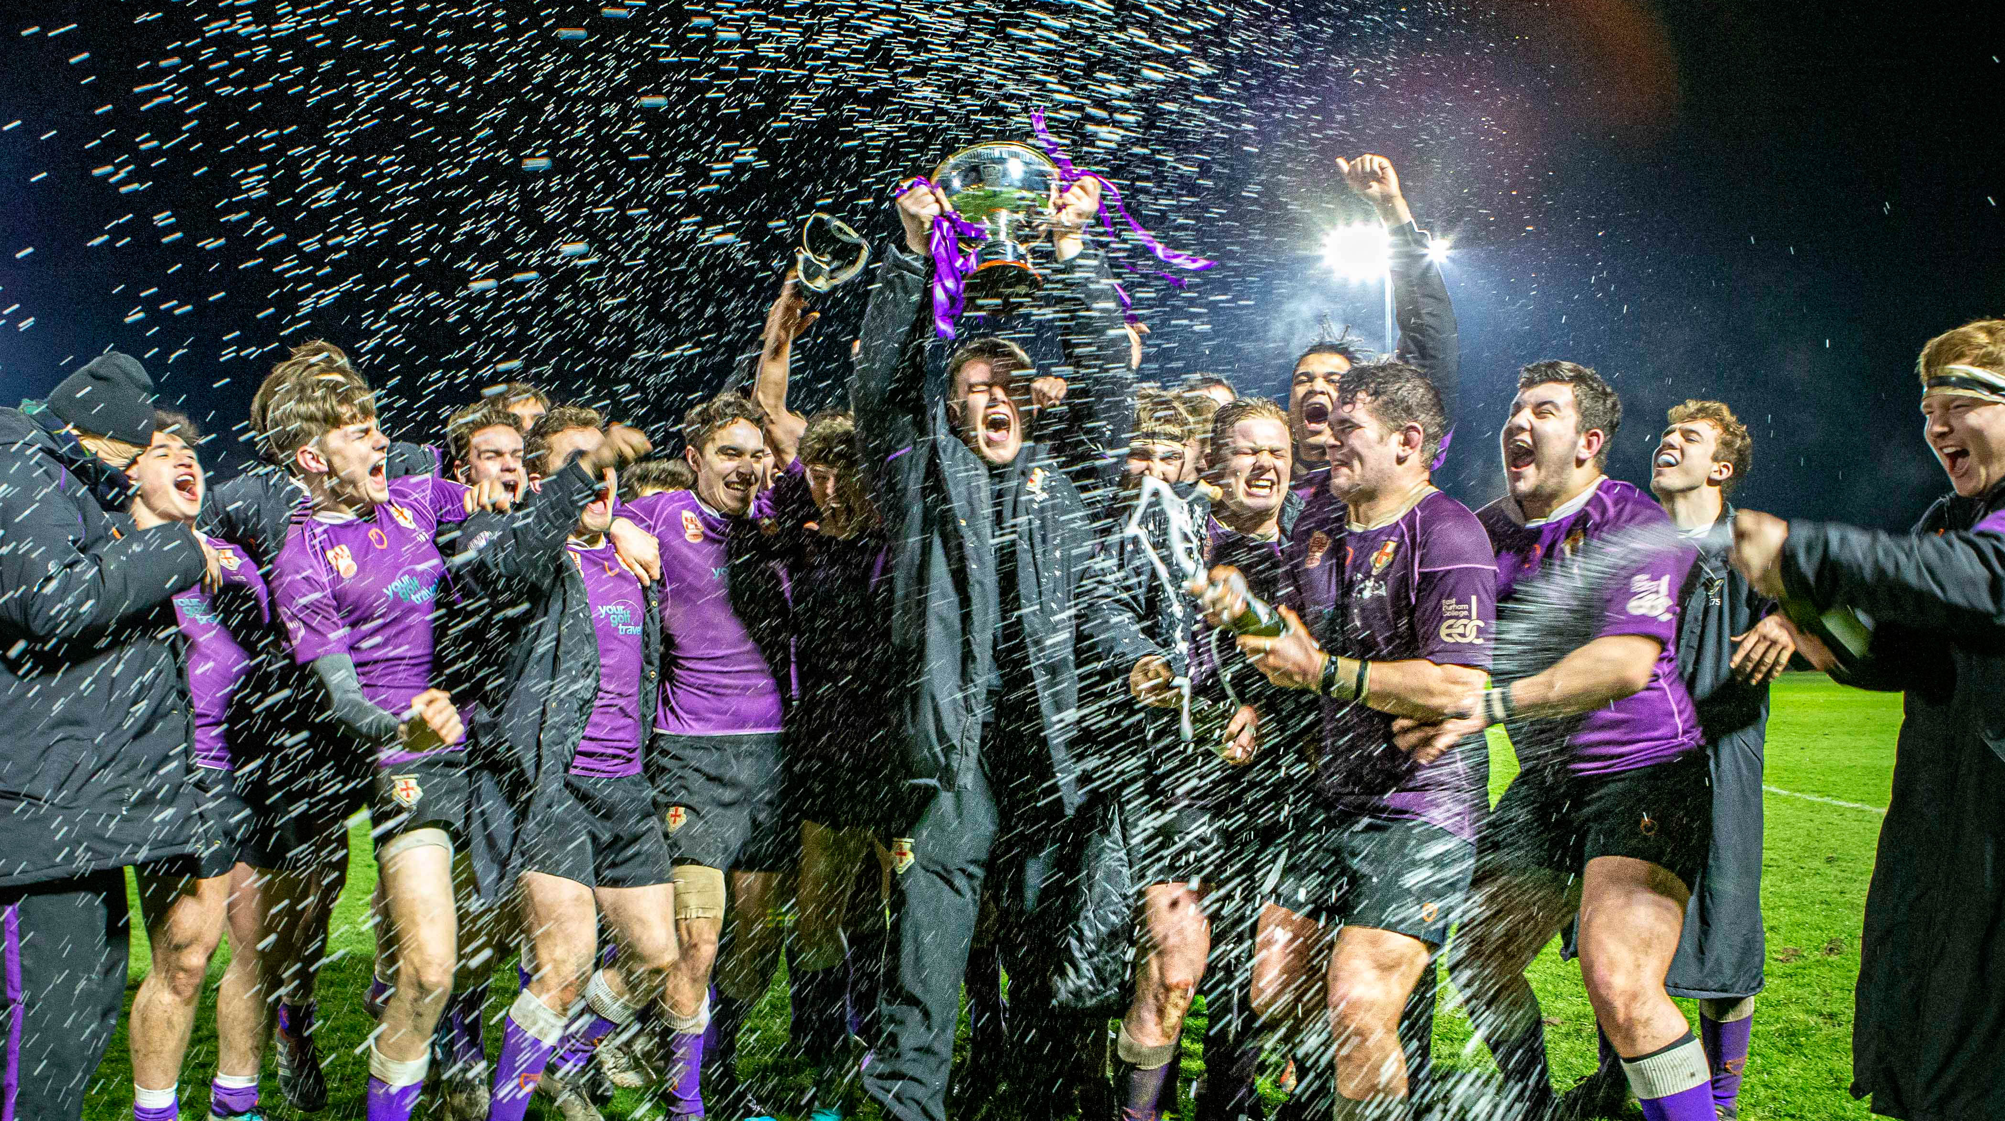
Brochure Production | 2022/23 Season

